Slide 1

Capstone Project : Britties Yoga Snack

Slide 2
"Britties" is a new snack, created and developed for the yoga community. It was created by three students who were studying business at New York University (NYU) and wanted to start their entrepreneurial life. One of them was also a yoga professor, who saw a need of a new snack for the yoga community. The product they created has the best taste and amount of protein per snack and they claimed that it would be a hit their product. In order validate their idea , the want to launch a pilot in the NY area, but due the limitation in their budget, they must focus in just one area of NY to do the pilot, so they want to apply their data science knowledge in order to find the proper area .
Problem and Backgound

Slide 3

StakeHOLDERS
The main stakeholders would be the NY citizens, the yoga community and the three fellow students

Slide 4


The data that would be used for the project will be the NY Map with the neighbor's name, latitude, longitude, among other things given by the IBM Specialization, and the data of the yoga places that will be segmented in Foursquare by the category ID:4bf58dd8d48988d102941735
Working with the data

Slide 5
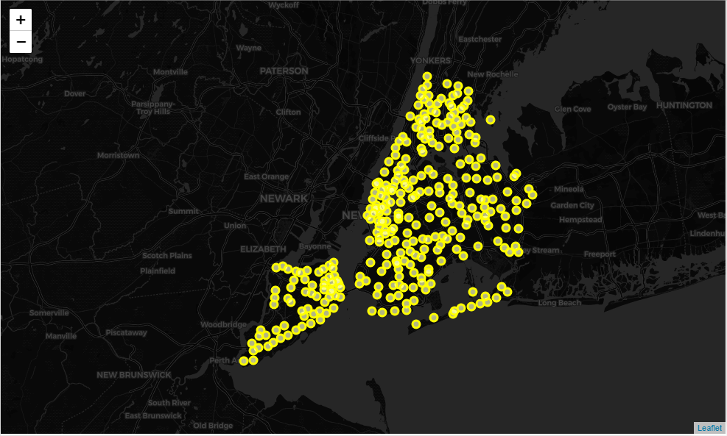
After importing the first data set, we can visualize the NY distribution that has 5 boroughs and different neighborhoods. Now what we would do is to connect this location with the category data in Foursquare.

Slide 6
AFTER CONNECTING THE DATA WITH THE FOURSQUARE API, LIMITING THE RESULT TO 500 VENUE ( MAXIMUM VENUES WITH THE CURRENT ACCOUNT), WE GOT THE FOLLOWING RESULTS FOR THE YOGA PLACES (category ID:4bf58dd8d48988d102941735) IN NY.
Numbers of Yoga Studio in Bronx = 9
Numbers of Yoga Studio in Manhattan = 227
Numbers of Yoga Studio in Brooklyn = 189
Numbers of Yoga Studio in Queens = 64
Numbers of Yoga Studio in Staten Island = 14
WE CAN VISUALIZE THAT THE TWO MOST IMPORTANT PLACES FOR THE YOGA STUDIO ARE NY AND BROOKLYN. NOW LET’S VISUALIZE THE RESULTS
Connecting the Data

Slide 7
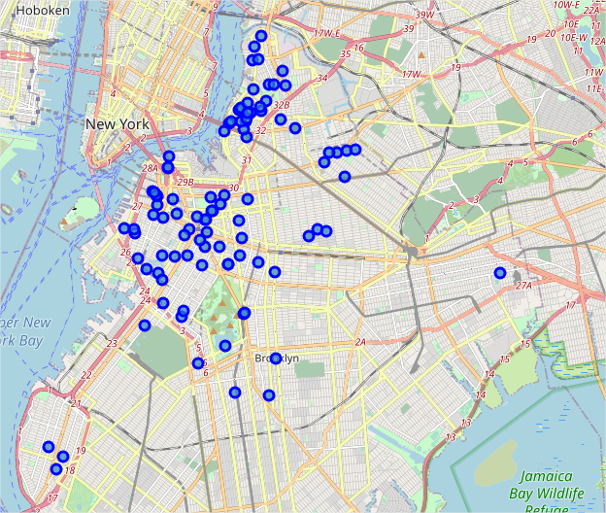
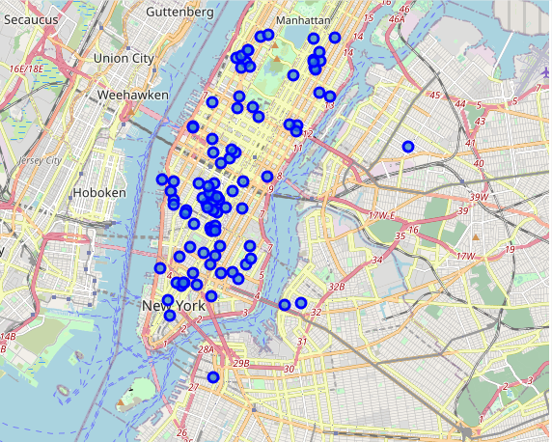
Foursquare API Map Visualization
Brooklyn
Manhattan

Slide 8
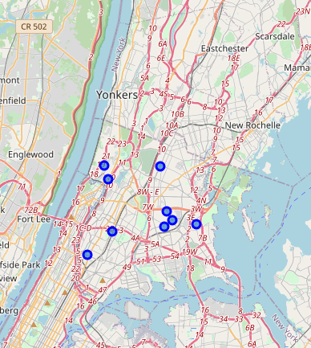
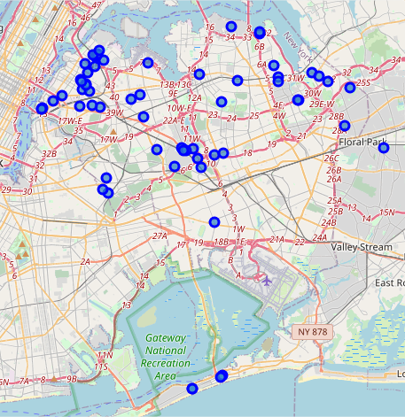
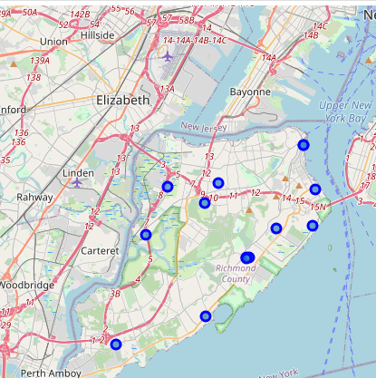
Foursquare API Map Visualization
Bronx
Queens
Staten Island

Slide 9
Now that we have all the points and we already now that Brooklyn and Manhattan are the boroughs who have more yoga places, is necessary to calculate the density of the points, because , the young students want to focus just in one area, so we calculate the mean distance obtaining the following results:
Bronx Mean Distance from Mean coordinates: 0.03473164580176437
Manhattan Mean Distance from Mean coordinates: 0.027892266753226636
Brooklyn Mean Distance from Mean coordinates: 0.031715273837678366
Queens Mean Distance from Mean coordinates: 0.07369320949347496
Staten Island Mean Distance from Mean coordinates: 0.050034817407765574
WE CAN SEE THAT MANHATTAN IS THE BOROUGH WITH MORE DENSITY OF PLACES , FOLLOWING IN SECOND PLACE BY BROOKLYN
Analyzing the Data

Slide 10
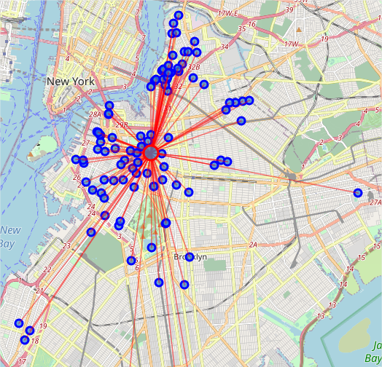
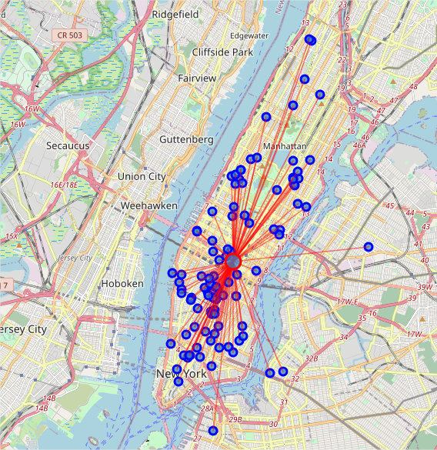
Foursquare API Density Map Visualization
Brooklyn
Manhattan

Slide 11
AFTER EVALUATING THE YOGA PLACES DISTRIBUTION IN NY, ME CAN HIGHLY RECOMMEND TO TRY THE LAUNCH PILOT IN MANHATTAN, BECAUSE IT IS THE PLACE WITH MORE YOGA STUDIOS AND ALSO WITH THE HIGHEST DENSITY. HOWEVER IF THE BUDGET OF THE STUDENTS IS REALLY LIMITED BROOKLYN CAN BE ALSO AN OPTIMAL SOLUTION ACCORDING WITH THE ENTERPRISE , BECAUSE IT HAS A GOOD NUMBER OF YOGA PLACES AND ALSO A HIGH DENSITY WITHIN THE AREA
CONCLUSION

